Slide 1
USA Marketing Report
December 2024
Stuart Event Rentals

Slide 2
Year to date budget update
Total Budget:
$436,625
Total Y2D Spend:
$209,283
ASR – Stuart Event Rentals

Slide 3
Monthly summary
Retargeting Underperformance: Despite ongoing efforts, retargeting campaigns continue to underperform in engagement and conversions.
Yelp Continues to Drive Leads: Yelp remains the primary source for forms and calls, consistently driving significant traffic and engagement.
LinkedIn Growth: LinkedIn activity has shown a substantial increase in impressions, engagements, and followers, highlighting effective content strategies.
Instagram Growth: Instagram has demonstrated growth in followers and engagement, with specific posting times proving to be most effective for reaching the audience.
Cart Recovery Success: 13 abandoned carts recovered, with a recovery rate of 28.89%, adding $4,610.95 in revenue.
Next Steps: Enhance LinkedIn engagement strategies to maintain follower growth and interaction, optimize Instagram posting schedules to maximize reach, and continue refining cart recovery efforts to increase recovery rates and revenue. Additionally, reassess the performance of retargeting campaigns to improve their effectiveness.
ASR – Stuart Event Rentals

Slide 4
Major/notable monthly spend
$7900 Hospitality/Client Incentive spend for Holiday Gifts
ASR – Stuart Event Rentals

Slide 5
Website traffic – December FY25
stuartrental.com
Notes:
NOTE: Bounce Rate has been updated to Engagement Rate. GA4 does not report Bounce Rate; emphasizing engaged sessions instead of bounces. This provides a better understanding of how effectively different traffic sources are contributing to user engagement on the site.
Doc does not specify if Average Engagement time is to be reported in seconds or minutes.
NOTE: The above ASR numbers are reported in seconds.

Slide 6
Website traffic December FY25
Total Users vs. Submission Types:
Total Submissions Per Website Form:
Site Form Submissions by User Type (December FY25):
stuartrental.com
Notes:
NOTE: Bounce Rate has been updated to Engagement Rate. GA4 does not report Bounce Rate; emphasizing engaged sessions instead of bounces. This provides a better understanding of how effectively different traffic sources are contributing to user engagement on the site.
Doc does not specify if Average Engagement time is to be reported in seconds or minutes.
NOTE: The above ASR numbers are reported in seconds.

Slide 7
Website traffic – December FY25
Abandoned Cart Recovery Report December 2024
Recovered Revenue: $4,610.95
Remaining Recoverable Revenue: $39,126.35
Average Recovered Order Value: $254.69
Average Recoverable Order Value: $1397.37
Abandoned Cart Total Orders: 45
Recoverable Orders: 28
Recovered Orders: 13
Lost Orders: 4
Recovery Rate: 28.89%
stuartrental.com
Notes:
NOTE: Bounce Rate has been updated to Engagement Rate. GA4 does not report Bounce Rate; emphasizing engaged sessions instead of bounces. This provides a better understanding of how effectively different traffic sources are contributing to user engagement on the site.
Doc does not specify if Average Engagement time is to be reported in seconds or minutes.
NOTE: The above ASR numbers are reported in seconds.

Slide 8
Website traffic – December FY25
Traffic Source:
Engagement Rate by Traffic Source:
2024
2023
Previous Year
2023
Average Engagement Time by Traffic Source:
2024
2023
2023
2023
2024
2024
2023
stuartrental.com
Notes:
NOTE: Bounce Rate has been updated to Engagement Rate. GA4 does not report Bounce Rate; emphasizing engaged sessions instead of bounces. This provides a better understanding of how effectively different traffic sources are contributing to user engagement on the site.
Doc does not specify if Average Engagement time is to be reported in seconds or minutes.
NOTE: The above ASR numbers are reported in seconds.

Slide 9
Website traffic – December FY25
Users by U.S. City (Top 10):
stuartrental.com

Slide 10
Website traffic – December FY25
Most Visited Pages (Top 10):
stuartrental.com
Notes:
By views

Slide 11
Website traffic learnings & action points
User Demographics:
Local Traffic Dominance: High engagement remains from key local areas, with the San Jose region leading in user volume. Notably, traffic from Azure data centers has decreased, indicating a decline in non-local or bot traffic.
Engagement Metrics:
Stable User Visits with Improved Retention: Slight increase in returning users; implement loyalty programs or targeted promotions.
Focus on Cart and Inquiry Form Submissions: With cart submissions still dominant, optimize checkout process and inquiry form visibility.
Traffic Sources:
Organic Search Still Dominant: Slight decrease in traffic; enhance SEO strategies, focusing on most visited pages like party rentals and event setups.
Refine Paid and Social Campaigns: Review and adjust paid campaigns based on performance metrics to increase ROI.
Action Points:
Optimize Content for High Traffic Pages: Utilize analytics to update and create engaging content on high-traffic pages to improve stickiness.
Improve Engagement for Key Demographics: Tailor marketing efforts to core user bases in San Jose and surrounding areas, considering user behavior trends.
Enhance Mobile Experience: With a significant portion of traffic from mobile, ensure all new content is optimized for mobile viewing and interaction.
Increase Abandoned Cart Recovery Efforts: Intensify efforts to reclaim lost sales through timely and appealing follow-up emails, given the significant remaining recoverable revenue.
ASR – Stuart Event Rentals

Slide 12
SEM Campaign Updates – December FY25
Site Visits by Traffic Source:
Forms, Emails, and Messages by Traffic Source:
Calls by Traffic Source:
ASR – Stuart Event Rentals

Slide 13
SEM Campaign learnings & action points
Yelp Dominance in Engagement: Yelp remains the leader for user interactions via forms, emails, and messages.
Action Point: Continue to optimize the Yelp profile. Consider introducing exclusive Yelp offers or featured listings to enhance visibility and interaction rates.
Google as Primary Traffic Driver: Google still drives the majority of site visits, maintaining its role as a primary traffic source.
Action Point: AdWords campaigns focusing on high-conversion keywords and improve landing page experiences to boost conversion rates.
Retargeting Campaigns Underperforming: Retargeting efforts are showing lower impact on engagement and conversions relative to other channels.
Action Point: Audit current retargeting strategies; test different ad creatives and segmentation to increase effectiveness.
Minor Impact from Edge but Opportunities Exist: Edge provides some traffic but lacks significant engagement or conversion.
Action Point: Evaluate the performance metrics of Edge campaigns; consider reallocating budget to more productive channels or refine targeting on Edge for better results.
Calls Driven Predominantly by Google and Yelp: Calls primarily generated from Google and Yelp, indicating strong direct and review-driven engagement.
Action Point: Enhance call-to-action features in Google and Yelp ads and ensure quick response capabilities are in place to handle inquiries efficiently.
ASR – Stuart Event Rentals
Notes:
Retargeting audit considerations:
Segmentation: Are we able to segment users based on their behavior on the site (e.g., product categories viewed, time on site, or visits to key pages like tenting)?
Exclusion Lists: Do we have the ability to exclude users who have already converted, as well as those with low engagement (e.g., bounced quickly)?
Creative Optimization: Are we running product-specific or dynamic retargeting ads to show users more personalized and relevant content?
Frequency Cap: Do we have a frequency cap in place to avoid overwhelming users with too many ads?
Platform Testing: Are we currently running retargeting ads across multiple platforms (Google, Facebook, etc.) to see which performs best for our audience?

Slide 14
Social Media - LinkedIn
Most engaging times to post:
2:00 PM PST
&
6:30 PM PST
ASR – Stuart Event Rentals
Notes:
Select each chart, right click and select ‘edit data’ – update each column with data from the Sendible reports hub.
For the engagement rate chart, do not edit the engagement rate column, it will be calculated automatically when you fill in the impression and engagements data.
For the follower chart please just update the ‘followers gained column’ and the total followers will update automatically.
Please make sure you update the date range to the relevant month before recording the data.

Slide 15

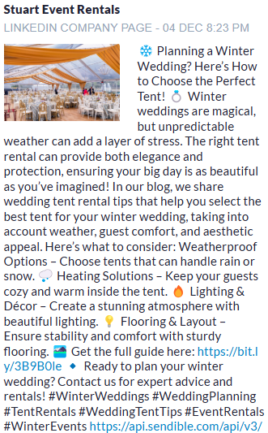
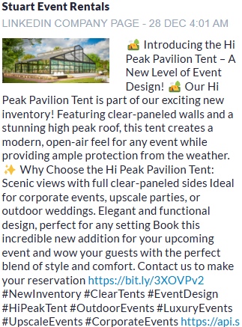
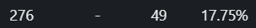
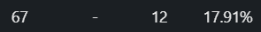
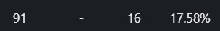
LinkedIn- Most Engaging Post
ASR – Stuart Event Rentals
Notes:
Include a screenshot of the most successful posts from the Sendible reports hub.

Slide 16
Social Media - LinkedIn
ASR – Stuart Event Rentals
Notes:
Select each chart, right click and select ‘edit data’ – replace the sample data in each column with the relevant data. The easiest place to get all of this information is the LinkedIn analytics section for the relevant page.
Please make sure you update the date range to the relevant month before recording the data.

Slide 17
Social Media - Instagram
Most engaging times to post:
12:OO PM PST
&
6:15 PM PST
ASR – Stuart Event Rentals
Notes:
Select each chart, right click and select ‘edit data’ – update each column with data from the relevant place:
Total impressions vs engagement rate – Instagram professional dashboard
Followers vs Non-Followers reached - Instagram professional dashboard
Followers gained vs total followers – Sendible reports hub
Most engaging times to post – Sendible reports hub
Please make sure you update the date range to the relevant month before recording the data.
NOTE; Age range has increased 10 years. It was 25-34 and now is 35-44.

Slide 18
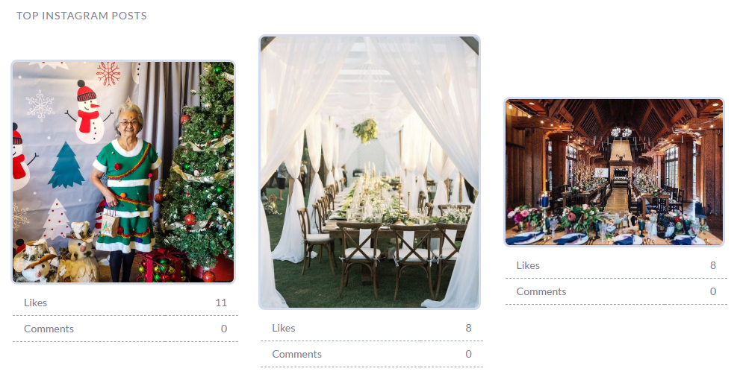
Social Media - Instagram
ASR – Stuart Event Rentals
Notes:
Include a screenshot of the most successful posts from the Sendible reports hub.

Slide 19
Social Media learnings & recommendations
LinkedIn Insights:
Event Planning Focus: January is peak planning season for spring and summer events. Posts offering tips on selecting the perfect rentals for weddings, corporate gatherings, or festivals encourage early bookings and establish your expertise.
Content Impact: Share behind-the-scenes stories, like setting up large-scale events, or feature trends in event decor (e.g., "Top Rental Trends for 2025"). These posts appeal to event planners and industry professionals looking for inspiration.
Instagram Insights:
Visual Inspiration: Customers often look for fresh ideas in January. Showcase styled event setups featuring trending items like ghost chairs, draping, or bold-colored linens to inspire your followers. Use carousel posts or Reels to highlight different looks.
Engagement Driver: Encourage followers to interact by posting polls or asking questions like, "What’s your must-have rental for 2025?" or "Which table setting style do you love the most?" This not only drives engagement but provides insights into customer preferences.
Facebook Insights:
Seasonal Inventory Spotlight: Use January to highlight essential items for winter events, such as heaters, fire pits, and cozy lounge furniture. Posts featuring these products in use at past events can inspire customers planning winter celebrations.
Community Building: Share photos from recent events you helped execute and invite your audience to tag friends who might be planning events. This creates a sense of community and showcases your brand’s role in memorable moments.
ASR – Stuart Event Rentals
Notes:
Highlight social media ‘wins’ for the month as well as key learnings – how will you use this information to inform your content strategy moving forward?

